Slide 1
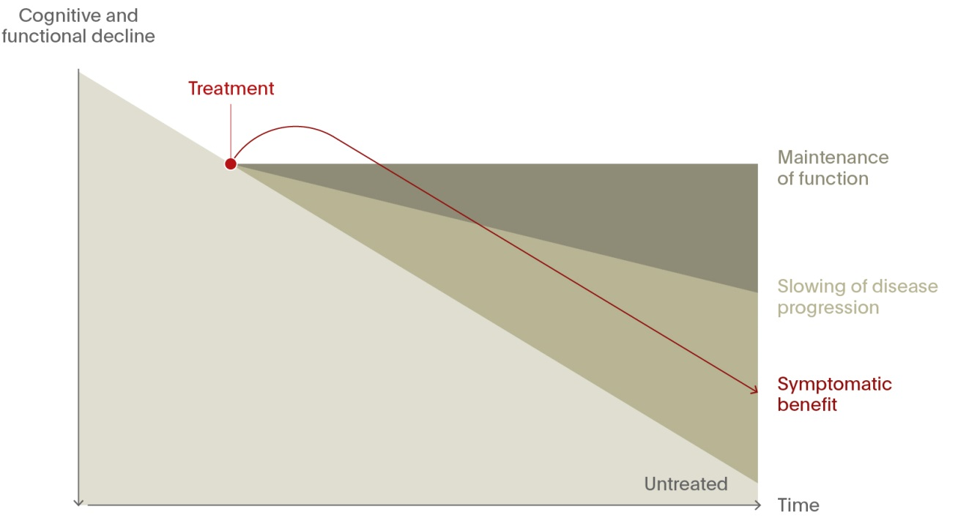
Symptomatic and disease-modifying treatments
Alzheimer’s Disease (AD)
Treatments for AD can be theoretically classified according to whether they affect:¹
the symptoms of the disease
(‘symptomatic treatments’)
the underlying pathology of the disease
(‘disease-modifying treatments’).
The current treatments for AD are symptomatic.² New disease-modifying treatments are currently being investigated that can potentially affect the underlying pathology of the disease.³
A disease-modifying treatment would either stop or slow the progressive decline of the patient.¹ Consequently, the patient’s trajectory of decline would be less steep, diverging at an acute angle from that of an untreated patient.¹ The larger the disease-modifying effect, the greater this divergence, and the sooner that the benefit of treatment would be clinically observable.¹
Even when disease-modifying treatments become available, they will not necessarily restore a patient’s function to premorbid levels, and so symptomatic therapies will still have a role to play.¹
1. Kennedy. Primary Psychiatry. 2013;
2. Winblad et al. Lancet Neurol 2016;15(5):455–532;
3. Tolar, M., et al. Alz Res Therapy 12, 95 (2020).
4. Adapted from: Van Dam & De Deyn. Nat Rev Drug Discov 2006;5(11):956–970
Notes:
Full reference details:
Kennedy GJ. From symptom palliation to disease modification: implications for dementia care. Primary Psychiatry 2013. http://primarypsychiatry.com/from-symptom-palliation-to-disease-modification-implications-for-dementia-care/. Accessed 26 August 2016.
Van Dam D, De Deyn PP. Drug discovery in dementia: the role of rodent models. Nat Rev Drug Discov 2006; 5 (11): 956–970.
Winblad B, Amouyel P, Andrieu S, et al. Defeating Alzheimer’s disease and other dementias: a priority for European science and society. Lancet Neurol 2016; 15 (5): 455–532.

